Slide 1
Declarative Analytics on Heterogeneous Exascale Systems
PhD Proposal by
Ahmedur Rahman Shovon
Committee Members
Dr. Sidharth Kumar, Chair and Advisor
Dr. Michael E. Papka
Dr. Zhiling Lan
Dr. Stavros Sintos
Dr. Gopikrishna Deshpande, Auburn University
Dr. Thomas Gilray, Washington State University

Slide 2
Roadmap
Introduction and motivation
Background
Enabling declarative analytics on heterogenous System
Off-the-shelf implementations (Accomplished)
Hash table on GPU (Accomplished)
Hash Join (Accomplished)
Hash indexed sorted array (Accomplished)
Multi-node multi-GPU implementation (Current focus)
Exploration of declarative scientific analytics
Declarative topological data analysis (Accomplished)
Persistent homology using declarative analytics (Current focus)
Timeline
Conclusion
Notes:
Let's begin with an introduction and the motivation behind this proposal

Slide 3
Declarative Analytics on Heterogeneous Exascale Systems
Users expresses what to achieve with the data rather than how to accomplish it
User
UserID | UserName | UserEmail | Country
101 | Alice | alice@example.com | USA
102 | Bob | bob@example.com | USA
103 | Eve | eve@example.com | Australia
WHAT
HOW
SELECT UserID FROM User WHERE Country = 'USA';
Another approach: Datalog (suitable for recursive queries)
Makrynioti, N., & Vassalos, V. (2019). Declarative data analytics: A survey. IEEE Transactions on Knowledge and Data Engineering, 33(6), 2392-2411.
Salesforce. (2024). Click, Not Code: The Benefits of Declarative Programming vs. Imperative Programming retrieved from https://www.salesforce.com/products/platform/best-practices/declarative-programming-vs-imperative-programming/ on 01/24/2026
Notes:
Declarative analytics enables users to focus on what they want to achieve with the data, rather than worrying about how it is computed

Slide 4
Declarative Analytics on Heterogeneous Exascale Systems
1
G
1
T
0
3
4
0
3
4
2
Transitive Closure using Recursive SQL
2
Transitive Closure using Datalog
-- Recursive CTE for Transitive Closure
WITH RECURSIVE TransitiveClosure AS ( -- Base case: start with the initial edges SELECT source, target FROM edges UNION -- Recursive case: find new edges by joining with previous results SELECT tc.source, e.target FROM TransitiveClosure tc JOIN edges e ON tc.target = e.source )
SELECT DISTINCT source, target FROM TransitiveClosure;
Datalog simplifies recursive queries
// Base case: Direct edges
tc(X, Y) :- edges(X, Y).
// Recursive case: Indirect connections
tc(X, Z) :- tc(X, Y), edges(Y, Z).
Shovon, A. R. (2024, April 23). Recursive queries in SQL and Datalog. Ahmedur Rahman Shovon. Retrieved June 22, 2024, from https://arshovon.com/blog/recursive-queries/

Slide 5
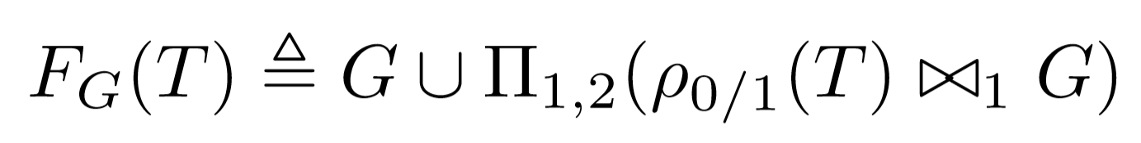
Declarative Analytics on Heterogeneous Exascale Systems
Datalog Rules
Iterative
Relational Algebra
tc(X, Y) :- edges(X, Y).
tc(X, Z) :- tc(X, Y), edges(Y, Z).
Relational algebra:
Union
Projection
Join
Gilray, T., & Kumar, S. (2019, December). Distributed relational algebra at scale. In 2019 IEEE 26th International Conference on High Performance Computing, Data, and Analytics (HiPC) (pp. 12-22). IEEE.

Slide 6
Transitive Closure: Iterations
1
T
0
3
4
2
0​ | 1​
0​ | 2​
1​ | 3​
2​ | 3​
3​ | 4​

Slide 7
Transitive Closure: Iterations 1
1
1
T
0
3
4
0
3
4
2
2
0​ | 1​
0​ | 2​
1​ | 3​
2​ | 3​
3​ | 4​
0​ | 1​
0​ | 2​
1​ | 3​
2​ | 3​
3​ | 4​
0​ | 3​
1​ | 4​
2​ | 4​

Slide 8
Transitive Closure: Iterations 2
1
1
1
T
0
3
4
0
3
4
0
3
4
2
2
2
0​ | 1​
0​ | 2​
1​ | 3​
2​ | 3​
3​ | 4​
0​ | 1​
0​ | 2​
1​ | 3​
2​ | 3​
3​ | 4​
0​ | 3​
1​ | 4​
2​ | 4​
0​ | 1​
0​ | 2​
1​ | 3​
2​ | 3​
3​ | 4​
0​ | 3​
1​ | 4​
2​ | 4​
0​ | 4​

Slide 9
Transitive Closure: Iterations 3
Union
Projection
Join
1
1
1
1
T
0
3
4
0
3
4
0
3
4
0
3
4
2
2
2
2
0​ | 1​
0​ | 2​
1​ | 3​
2​ | 3​
3​ | 4​
0​ | 1​
0​ | 2​
1​ | 3​
2​ | 3​
3​ | 4​
0​ | 3​
1​ | 4​
2​ | 4​
0​ | 1​
0​ | 2​
1​ | 3​
2​ | 3​
3​ | 4​
0​ | 3​
1​ | 4​
2​ | 4​
0​ | 4​
0​ | 1​
0​ | 2​
1​ | 3​
2​ | 3​
3​ | 4​
0​ | 3​
1​ | 4​
2​ | 4​
0​ | 4​

Slide 10
Declarative Analytics Applications
Graph mining
Static analysis
Deductive database
Machine learning
Datalog
Notes:
Graph Mining for community detection
Static Analysis analyzing program behavior, such as identifying bugs, verifying security properties, or performing dependency analysis
Deductive Databases for complex recursive queries
Machine Learning for explainable AI
Its declarative nature makes it ideal for scaling these tasks on heterogeneous exascale systems

Slide 11



Declarative Analytics on Heterogeneous Exascale Systems
Datalog
Relational algebra
Heterogeneous exascale systems
High performance implementation for highly expressive language
Notes:
Write queries on a very high level language that runs on a supercomputer

Slide 12


Declarative Analytics on Heterogeneous Exascale Systems
Ability of a computer system to perform 1 Exaflop or more
1 Exaflop = 1 quintillion flop (10¹⁸) or 10⁹ Gigaflop
1.742 Exaflop/s (LLNL)
1.353 Exaflop/s (ORNL)
Node 0
Node 1
Node n
1.012 Exaflop/s (ANL)
High Bandwidth Network
Top500 Supercomputer Highlights - November 2024 retrived from https://top500.org/lists/top500/2024/11/highs/

Slide 13
Datalog Implementations
Multi-threaded
Distributed
(Apache Spark)
Multi-node
Multi-threaded
Single-GPU
Multi-node
Multi-GPUs
Soufflé
RDFox
SLOG
GPUJoin
LogicBlox
Radlog
PRAM
GPULog
Nemo
BigDatalog
GPUDatalog
Herbert Jordan, Bernhard Scholz, and Pavle Subotić. 2016. Soufflé: On synthesis of program analyzers. In Computer Aided Verification: 28th International Conference, CAV 2016, Toronto, ON, Canada, July 17-23, 2016, Proceedings, Part II 28, Swarat Chaudhuri and Azadeh Farzan (Eds.). Springer, Springer International Publishing, Cham, 422–430.
Boris Motik, Yavor Nenov, Robert Piro, Ian Horrocks, and Dan Olteanu. 2014. Parallel materialisation of datalog programs in centralised, main-memory RDF systems. In Proceedings of the AAAI Conference on Artificial Intelligence, Vol. 28.
Shkapsky, A., Yang, M., Interlandi, M., Chiu, H., Condie, T., & Zaniolo, C. (2016, June). Big data analytics with datalog queries on spark. In Proceedings of the 2016 International Conference on Management of Data (pp. 1135-1149).
Yavor Nenov, Robert Piro, Boris Motik, Ian Horrocks, Zhe Wu, and Jay Banerjee. 2015. RDFox: A Highly-Scalable RDF Store. In The Semantic Web - ISWC 2015, Marcelo Arenas, Oscar Corcho, Elen Simperl, Markus Strohmaier, Mathieu d’Aquin, Kavitha Srinivas, Paul Groth, Michel Dumontier, Jeff Heflin, Krishnaprasad Thirunarayan, and Steffen Staab (Eds.). Springer International Publishing, Cham, 3–20.
Gilray, T., Sahebolamri, A., Sun, Y., Kunapaneni, S., Kumar, S., & Micinski, K. (2024). Datalog with First-Class Facts. arXiv preprint arXiv:2411.14330.
Notes:
Multi-threaded: Limited scalability
Distributed: High overhead for introduced by Spark framework recursive queries
Multi-node Multi-threaded: Lacks GPU acceleration
Single-GPU: Bound by single GPU limitations

Slide 14
Traditional Graph Mining Applications
Applications
Transitive closure
Connected components
Same generation
Triangle counting
tc(X, Y) :- edges(X, Y).
tc(X, Z) :- tc(X, Y), edges(Y, Z).
2cl(X, Y) :- edges(X, Y), X < Y.
2cl(X, Y) :- edges(Y, X), X < Y.
triangles(X, Y, Z) :- 2cl(X, Y), 2cl(Y, Z), 2cl(X, Z).
cc(X, X) :- edges(X, _).
cc(Y, $MIN(Z)) :- cc(Y, Z), edges(X, Y).
sg(x, y) :- edges(p, x), edges(p, y), x ≠ y.
sg(x, y) :- edges(a, x), sg(a, b), edges(b, y), x ≠ y.
De Moor, O., Gottlob, G., Furche, T., & Sellers, A. (Eds.). (2012). Datalog Reloaded: First International Workshop, Datalog 2010, Oxford, UK, March 16-19, 2010. Revised Selected Papers (Vol. 6702). Springer.
Huang, S. S., Green, T. J., & Loo, B. T. (2011, June). Datalog and emerging applications: an interactive tutorial. In Proceedings of the 2011 ACM SIGMOD International Conference on Management of data (pp. 1213-1216).
Gilray, T., & Kumar, S. (2017). Toward parallel cfa with datalog, mpi, and cuda. In Scheme and Functional Programming Workshop.
Zomorodian, A. (2012). Topological data analysis. Advances in applied and computational topology, 70, 1-39.

Slide 15
Advancing Novel Graph Applications
Applications
Transitive closure
Connected components
Same generation
Triangle counting
Declarative Topological Data Analysis?
Topological Data Analysis
De Moor, O., Gottlob, G., Furche, T., & Sellers, A. (Eds.). (2012). Datalog Reloaded: First International Workshop, Datalog 2010, Oxford, UK, March 16-19, 2010. Revised Selected Papers (Vol. 6702). Springer.
Huang, S. S., Green, T. J., & Loo, B. T. (2011, June). Datalog and emerging applications: an interactive tutorial. In Proceedings of the 2011 ACM SIGMOD International Conference on Management of data (pp. 1213-1216).
Gilray, T., & Kumar, S. (2017). Toward parallel cfa with datalog, mpi, and cuda. In Scheme and Functional Programming Workshop.
Zomorodian, A. (2012). Topological data analysis. Advances in applied and computational topology, 70, 1-39.
Notes:
We are also exploring to extend connected components application into more advanced territory where we will compute topological features which track the number of connected components in fully connected network in the field of declarative TDA.

Slide 16






Research Proposal
Develop an efficient multi-node, multi-GPU Datalog backend with optimized iterative relational algebra operations and communication for traditional graph mining tasks like pathfinding and connected components, as well as novel graph applications in declarative topological data analysis
Accelerating Datalog applications with cuDF
Towards iterative relational algebra on the {GPU}
Optimizing Datalog for the GPU
Bruck Algorithm Performance Analysis for Multi-GPU All-to-All Communication
The robustness of persistent homology of brain networks to data acquisition‐related non‐neural variability in resting state fMRI
Topology assisted clustering of temporal fMRI brain networks with use-case in mitigating non-neural multi-site variability

Slide 17



List of publications
Conference Proceedings
Workshop Papers
Towards iterative relational algebra on the {GPU}
Bruck Algorithm Performance Analysis for Multi-GPU All-to-All Communication
Optimizing Datalog for the GPU
Accelerating Datalog applications with cuDF
Scalable, interactive and hierarchical visualization of virus taxonomic data
Acceptance rate: 19%
Acceptance rate: 44%
Acceptance rate: 15%
Acceptance rate: 42%
Journal Articles
Under Submission
The robustness of persistent homology of brain networks to data acquisition‐related non‐neural variability in resting state fMRI
UALCAN: An update to the integrated cancer data analysis platform
Topology assisted clustering of temporal fMRI brain networks with use-case in mitigating non-neural multi-site variability
UALCAN Mobile, an app for cancer gene expression data analysis
Impact factor: 5.038
Impact factor: 6.318

Slide 18
Roadmap
Introduction and motivation
Background
Enabling declarative analytics on heterogenous System
Off-the-shelf implementations (Accomplished)
Hash table on GPU (Accomplished)
Hash Join (Accomplished)
Hash indexed sorted array (Accomplished)
Multi-node multi-GPU implementation (Current focus)
Exploration of declarative scientific analytics
Declarative topological data analysis (Accomplished)
Persistent homology using declarative analytics (Current focus)
Timeline
Conclusion
Notes:
In the rest of this talk, I will provide background on the topic, highlight our completed research contributions leading to this proposal, and outline our current areas of focus.

Slide 19
Relational Algebra
Relational algebra (RA) comprises an important basis of operations for declarative analytics
Difference (−) Union (∪) Rename (ρ)
Selection (σ) Natural join (⨝) Projection (Π)
Intersection (∩)
Relation
UserID | UserName | UserEmail
101 | Alice | alice@example.com
102 | Bob | bob@example.com
Tuple
(Row)
Attribute (Column)
Sidharth Kumar and Thomas Gilray. Distributed relational algebra at scale. In International Conference on High Performance Computing, Data, and Analytics (HiPC). IEEE, 2019.
Sidharth Kumar and Thomas Gilray. Load-balancing parallel relational algebra. In International Conference on High Performance Computing, pages 288–308. Springer, 2020.

Slide 20
Example of Natural Join ⨝
User (Inner Relation)
Order (Outer Relation)
UserID | UserName | UserEmail
101 | Alice | alice@example.com
102 | Bob | bob@example.com
103 | Eve | eve@example.com
UserID | OrderTotal | Items
103 | 25.69 | 2
102 | 145.66 | 3
101 | 12.11 | 1
103 | 44.00 | 2
⨝

Slide 21
Example of Natural Join ⨝
User
Order
UserID | UserName | UserEmail
101 | Alice | alice@example.com
102 | Bob | bob@example.com
103 | Eve | eve@example.com
UserID | OrderTotal | Items
103 | 25.69 | 2
102 | 145.66 | 3
101 | 12.11 | 1
103 | 44.00 | 2
⨝
User
Order
UserID | UserName | UserEmail | OrderTotal | Items
101 | Alice | alice@example.com | 12.11 | 1

Slide 22
Example of Natural Join ⨝
User
Order
UserID | UserName | UserEmail
101 | Alice | alice@example.com
102 | Bob | bob@example.com
103 | Eve | eve@example.com
UserID | OrderTotal | Items
103 | 25.69 | 2
102 | 145.66 | 3
101 | 12.11 | 1
103 | 44.00 | 2
⨝
User
Order
UserID | UserName | UserEmail | OrderTotal | Items
101 | Alice | alice@example.com | 12.11 | 1
102 | Bob | bob@example.com | 145.66 | 3

Slide 23
Example of Natural Join ⨝
User
Order
UserID | UserName | UserEmail
101 | Alice | alice@example.com
102 | Bob | bob@example.com
103 | Eve | eve@example.com
UserID | OrderTotal | Items
103 | 25.69 | 2
102 | 145.66 | 3
101 | 12.11 | 1
103 | 44.00 | 2
⨝
User
Order
UserID | UserName | UserEmail | OrderTotal | Items
101 | Alice | alice@example.com | 12.11 | 1
102 | Bob | bob@example.com | 145.66 | 3
103 | Eve | eve@example.com | 25.69 | 2

Slide 24
Example of Natural Join ⨝
User
Order
UserID | UserName | UserEmail
101 | Alice | alice@example.com
102 | Bob | bob@example.com
103 | Eve | eve@example.com
UserID | OrderTotal | Items
103 | 25.69 | 2
102 | 145.66 | 3
101 | 12.11 | 1
103 | 44.00 | 2
⨝
User
Order
UserID | UserName | UserEmail | OrderTotal | Items
101 | Alice | alice@example.com | 12.11 | 1
102 | Bob | bob@example.com | 145.66 | 3
103 | Eve | eve@example.com | 25.69 | 2
103 | Eve | eve@example.com | 44.00 | 2

Slide 25
Example of Natural Join ⨝
User
Order
UserID | UserName | UserEmail
101 | Alice | alice@example.com
102 | Bob | bob@example.com
103 | Eve | eve@example.com
UserID | OrderTotal | Items
103 | 25.69 | 2
102 | 145.66 | 3
101 | 12.11 | 1
103 | 44.00 | 2
⨝
User
Order
UserID | UserName | UserEmail | OrderTotal | Items
101 | Alice | alice@example.com | 12.11 | 1
102 | Bob | bob@example.com | 145.66 | 3
103 | Eve | eve@example.com | 25.69 | 2
103 | Eve | eve@example.com | 44.00 | 2

Slide 26
Duplicates on Join Result
User ⨝ Order
UserID | UserName | UserEmail | OrderTotal | Items
101 | Alice | alice@example.com | 12.11 | 1
102 | Bob | bob@example.com | 145.66 | 3
103 | Eve | eve@example.com | 26.69 | 2
103 | Eve | eve@example.com | 44.00 | 2
Π(_{UserName,UserEmail})(User ⨝ Order)
UserName | UserEmail
Alice | alice@example.com
Bob | bob@example.com
Eve | eve@example.com
Eve | eve@example.com

Slide 27
Join Algorithms
Common Algorithms
Hash Join (HJ)
NLJ is suitable for small dataset SMJ is efficient with pre-sorted data HJ works on unsorted datasets through hash-based partitioning
Sort-Merge Join (SMJ)
Nested Loop Join (NLJ)
Bingsheng He, Ke Yang, Rui Fang, Mian Lu, Naga Govindaraju, Qiong Luo, and Pedro Sander. Relational joins on graphics processors. In Proceedings of the 2008 ACM SIGMOD international conference on Management of data, pages 511–524, 2008.
Ran Rui, Hao Li, and Yi-Cheng Tu. Join algorithms on gpus: A revisit after seven years. In 2015 IEEE International Conference on Big Data (Big Data), pages 2541–2550. IEEE, 2015.

Slide 28
Example of Hash Join ⨝
User (HashTable)
User (Inner Relation)
Order (Outer Relation)
UserID | UserName | UserEmail
102 | Bob | bob@example.com
101 | Alice | alice@example.com
103 | Eve | eve@example.com
UserID | OrderTotal | Items
103 | 25.69 | 2
102 | 145.66 | 3
101 | 12.11 | 1
103 | 44.00 | 2
UserID | UserName | UserEmail
103 | Eve | eve@example.com
101 | Alice | alice@example.com
102 | Bob | bob@example.com
Build
Probe
⨝
User
Order
UserID | UserName | UserEmail | OrderTotal | Items
103 | Eve | eve@example.com | 25.69 | 2
103 | Eve | eve@example.com | 44.00 | 2
101 | Alice | alice@example.com | 12.11 | 1
102 | Bob | bob@example.com | 145.66 | 3
Time complexity is O(M) + O(N) (building and probing hash table)

Slide 29
Roadmap
Introduction and motivation
Background
Enabling declarative analytics on heterogenous System
Off-the-shelf implementations (Accomplished)
Hash table on GPU (Accomplished)
Hash Join (Accomplished)
Hash indexed sorted array (Accomplished)
Multi-node multi-GPU implementation (Current focus)
Exploration of declarative scientific analytics
Declarative topological data analysis (Accomplished)
Persistent homology using declarative analytics (Current focus)
Timeline
Conclusion

Slide 30
Roadmap
Introduction and motivation
Background
Enabling declarative analytics on heterogenous System
Off-the-shelf implementations (Accomplished)
Hash table on GPU (Accomplished)
Hash Join (Accomplished)
Hash indexed sorted array (Accomplished)
Multi-node multi-GPU implementation (Current focus)
Exploration of declarative scientific analytics
Declarative topological data analysis (Accomplished)
Persistent homology using declarative analytics (Current focus)
Timeline
Conclusion

Slide 31
Our efforts on developing Datalog backend
Off-the-shelf
Started with CPU and GPU based Python libraries
Compare GPU capabilities for iterative join operations
GPUJoin
Relational Algebra (RA) operations using CUDA
High performance GPU hashtable for iterative RA
GPULog
CUDA based SIMD API for deductive analytics
Novel Hash-Indexed Sorted Array data structure
mnmgJOIN
CUDA + MPI based design (Work in progress )
Multi node multi GPU based engine
Shovon, A. R., Dyken, L. R., Green, O., Gilray, T., & Kumar, S. (2022, November). Accelerating datalog applications with cudf. In 2022 IEEE/ACM Workshop on Irregular Applications: Architectures and Algorithms (IA3) (pp. 41-45). IEEE.
Shovon, A. R., Gilray, T., Micinski, K., & Kumar, S. (2023). Towards iterative relational algebra on the {GPU}. In 2023 USENIX Annual Technical Conference (USENIX ATC 23) (pp. 1009-1016).
Sun, Y., Shovon, A. R., Gilray, T., Micinski, K., & Kumar, S. Optimizing Datalog for the GPU. ASPLOS 2025 (Accepted).
Sewell, A., Fan, K., Shovon, A. R., Dyken, L., Kumar, S., & Petruzza, S. (2024, January). Bruck algorithm performance analysis for multi-gpu all-to-all communication. In Proceedings of the International Conference on High Performance Computing in Asia-Pacific Region (pp. 127-133).

Slide 32
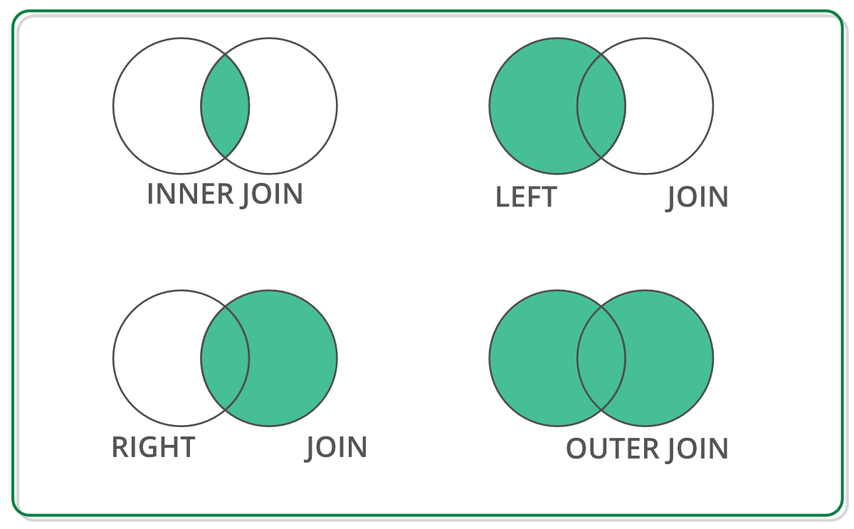
Off-the-shelf Data Structure for Join Operation
DataFrame has RA primitives APIs
DataFrame: 2D labeled tabular data structure
Reback, J., McKinney, W., Van Den Bossche, J., Augspurger, T., Cloud, P., Klein, A., ... & Seabold, S. (2020). pandas-dev/pandas: Pandas 1.0. 5. Zenodo.
Chen, D. Y. (2017). Pandas for everyone: Python data analysis. Addison-Wesley Professional.
Singh, R. (2020, July 1). Merging DataFrames with Pandas: Pd.merge(). Medium. Retrieved April 8, 2023, from https://medium.com/swlh/merging-dataframes-with-pandas-pd-merge-7764c7e2d46d

Slide 33


Off-the-shelf Python Libraries
DataFrame: 2D labeled tabular data structure
GPU (NVIDIA cuDF)
CPU
Both supports join operation with similar APIs
Reback, J., McKinney, W., Van Den Bossche, J., Augspurger, T., Cloud, P., Klein, A., ... & Seabold, S. (2020). pandas-dev/pandas: Pandas 1.0. 5. Zenodo.
Chen, D. Y. (2017). Pandas for everyone: Python data analysis. Addison-Wesley Professional.
Green, O., Du, Z., Patel, S., Xie, Z., Liu, H., & Bader, D. A. (2021, December). Anti-Section Transitive Closure. In 2021 IEEE 28th International Conference on High Performance Computing, Data, and Analytics (HiPC) (pp. 192-201). IEEE.
Fender, A., Rees, B., & Eaton, J. RAPIDS cuGraph. In Massive Graph Analytics (pp. 483-493). Chapman and Hall/CRC.

Slide 34
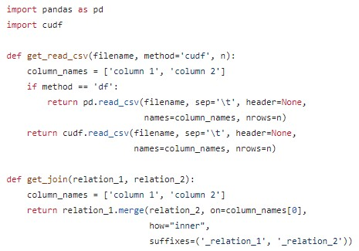
CPU (Pandas) and GPU (cuDF)
CPU Environment
GPU Environment
https://github.com/harp-lab/GPUJoin/edit/main/IA3_2022/basic_operations.py

Slide 35
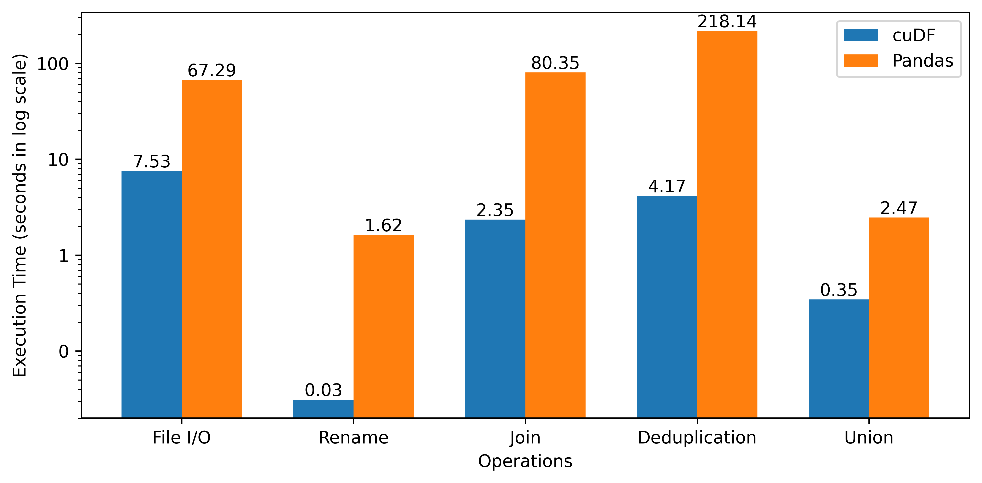
Performance Improvement for cuDF over Pandas (Standalone operations)
Shovon, A. R., Dyken, L. R., Green, O., Gilray, T., & Kumar, S. (2022, November). Accelerating datalog applications with cudf. In 2022 IEEE/ACM Workshop on Irregular Applications: Architectures and Algorithms (IA3) (pp. 41-45). IEEE.

Slide 36
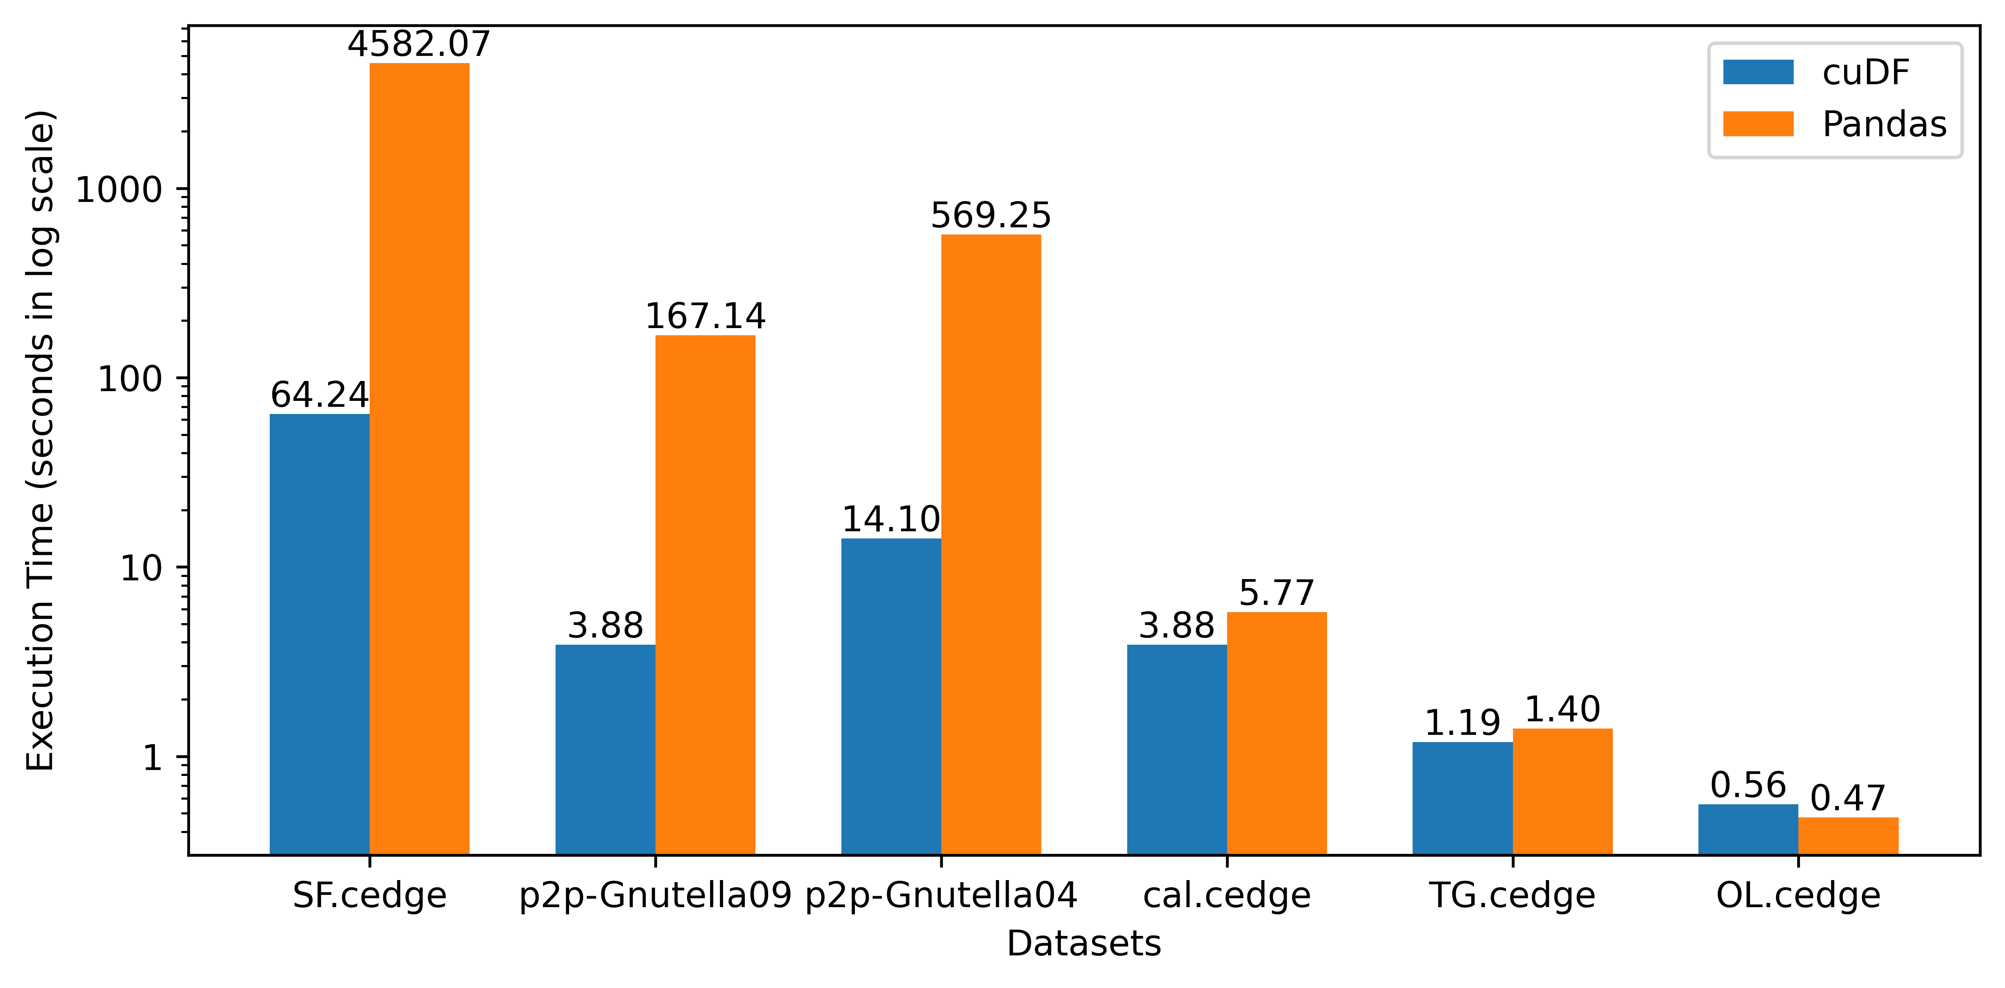
Performance Improvement for cuDF over Pandas (Transitive Closure)
Shovon, A. R., Dyken, L. R., Green, O., Gilray, T., & Kumar, S. (2022, November). Accelerating datalog applications with cudf. In 2022 IEEE/ACM Workshop on Irregular Applications: Architectures and Algorithms (IA3) (pp. 41-45). IEEE.

Slide 37
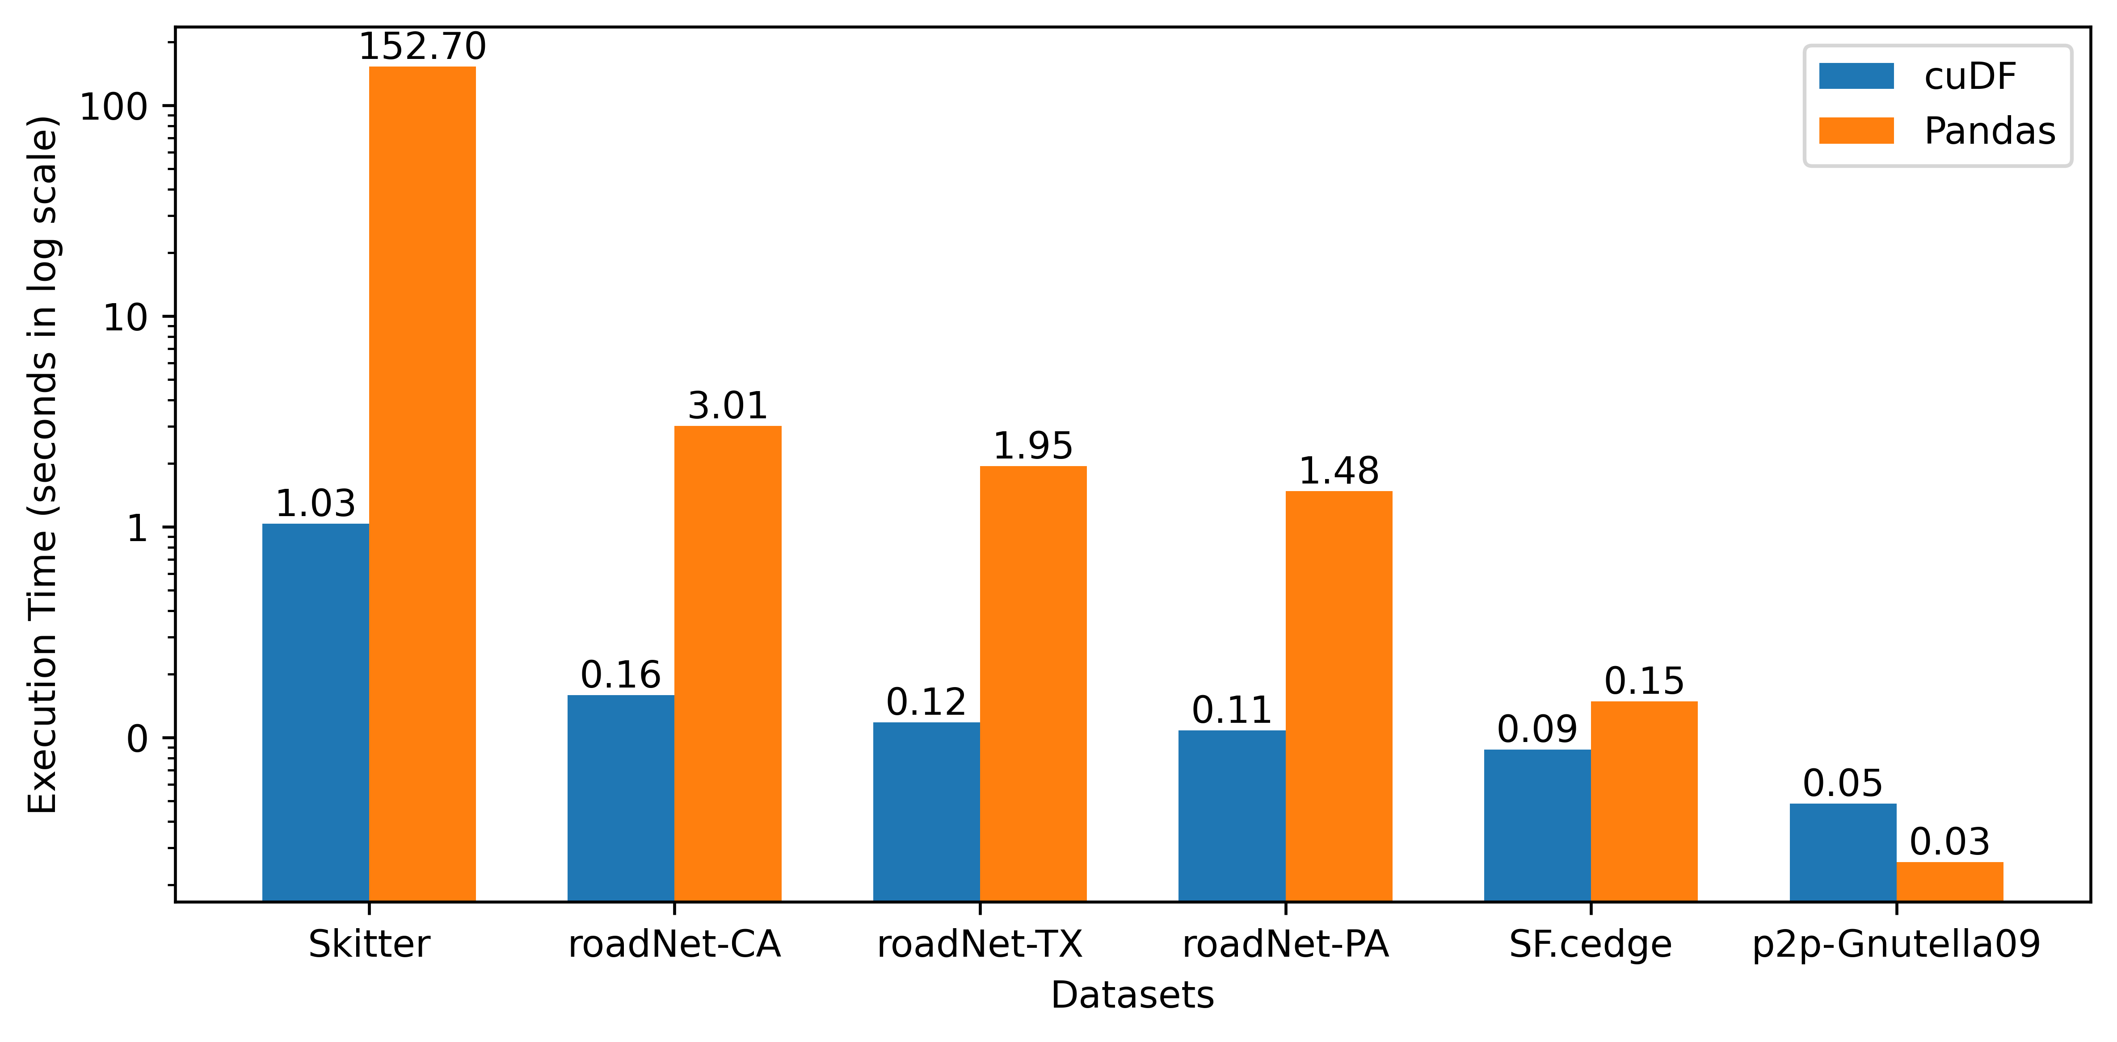
Performance Improvement for cuDF over Pandas (Triangle Counting)
Shovon, A. R., Dyken, L. R., Green, O., Gilray, T., & Kumar, S. (2022, November). Accelerating datalog applications with cudf. In 2022 IEEE/ACM Workshop on Irregular Applications: Architectures and Algorithms (IA3) (pp. 41-45). IEEE.

Slide 38
Improvement Opportunity
Open-addressing based hashtable
Fuse join and projection
Sorted results for deduplication
Pinned memory scheme
Intermediate memory clearance
A. R. Shovon, L. R. Dyken, O. Green, T. Gilray and S. Kumar, "Accelerating Datalog applications with cuDF," 2022 IEEE/ACM Workshop on Irregular Applications: Architectures and Algorithms (IA3), Dallas, TX, USA, 2022, pp. 41-45
Green, O., Du, Z., Patel, S., Xie, Z., Liu, H., & Bader, D. A. (2021, December). Anti-Section Transitive Closure. In 2021 IEEE 28th International Conference on High Performance Computing, Data, and Analytics (HiPC) (pp. 192-201). IEEE.

Slide 39
Roadmap
Introduction and motivation
Background
Enabling declarative analytics on heterogenous System
Off-the-shelf implementations (Accomplished)
Hash table on GPU (Accomplished)
Hash Join (Accomplished)
Hash indexed sorted array (Accomplished)
Multi-node multi-GPU implementation (Current focus)
Exploration of declarative scientific analytics
Declarative topological data analysis (Accomplished)
Persistent homology using declarative analytics (Current focus)
Timeline
Conclusion

Slide 40
Our efforts on developing Datalog backend
Off-the-shelf
Started with CPU and GPU based Python libraries
Compare GPU capabilities for iterative join operations
GPUJoin
Relational Algebra (RA) operations using CUDA
High performance GPU hashtable for iterative RA
GPULog
CUDA based SIMD API for deductive analytics
Novel Hash-Indexed Sorted Array data structure
mnmgJOIN
CUDA + MPI based design (Work in progress )
Multi node multi GPU based engine
Shovon, A. R., Dyken, L. R., Green, O., Gilray, T., & Kumar, S. (2022, November). Accelerating datalog applications with cudf. In 2022 IEEE/ACM Workshop on Irregular Applications: Architectures and Algorithms (IA3) (pp. 41-45). IEEE.
Shovon, A. R., Gilray, T., Micinski, K., & Kumar, S. (2023). Towards iterative relational algebra on the {GPU}. In 2023 USENIX Annual Technical Conference (USENIX ATC 23) (pp. 1009-1016).
Sun, Y., Shovon, A. R., Gilray, T., Micinski, K., & Kumar, S. Optimizing Datalog for the GPU. ASPLOS 2025 (Accepted).
Sewell, A., Fan, K., Shovon, A. R., Dyken, L., Kumar, S., & Petruzza, S. (2024, January). Bruck algorithm performance analysis for multi-gpu all-to-all communication. In Proceedings of the International Conference on High Performance Computing in Asia-Pacific Region (pp. 127-133).

Slide 41
Hash Table (Open Addressing, Linear Probing)
Grid Stride Loop
0
1
...
511
. . .
Block 0
35
44
11
23
. . .
. . .
0
1
...
511
46
31
. . .
Block n
97
32
CUDA Threads
Key - Value
Hash Table
Key-Value Pair

Slide 42
Hash Table (Open Addressing, Linear Probing)
Grid Stride Loop
Murmur 3 hashing
0
1
...
511
35
44
. . .
Block 0
35
44
11
23
11
23
. . .
. . .
0
1
...
511
AtomicCAS
46
31
. . .
Block n
97
32
CUDA Threads
Key - Value
Hash Table
Key-Value Pair

Slide 43
Hash Table (Open Addressing, Linear Probing)
Grid Stride Loop
Murmur 3 hashing
0
1
...
511
35
44
. . .
Block 0
35
44
11
23
11
23
. . .
. . .
0
1
...
511
AtomicCAS
46
31
. . .
Block n
97
32
CUDA Threads
Key - Value
Hash Table
Key-Value Pair

Slide 44
Hash Table (Open Addressing, Linear Probing)
Grid Stride Loop
Murmur 3 hashing
0
1
...
511
35
44
. . .
Block 0
35
44
11
23
11
23
. . .
. . .
0
1
...
511
AtomicCAS
46
31
. . .
Block n
97
32
CUDA Threads
Key - Value
Hash Table
Key-Value Pair

Slide 45
Hash Table (Open Addressing, Linear Probing)
Grid Stride Loop
Murmur 3 hashing
0
1
...
511
35
44
. . .
Block 0
35
44
11
23
11
23
. . .
. . .
0
1
...
511
AtomicCAS
46
31
. . .
Block n
97
32
Collision -> Linear probing (Position + 1) & hash table size
CUDA Threads
Key - Value
Hash Table
Key-Value Pair

Slide 46
Hash Table (Open Addressing, Linear Probing)
Grid Stride Loop
Murmur 3 hashing
0
1
...
511
35
44
. . .
Block 0
35
44
11
23
11
23
. . .
. . .
0
1
...
511
AtomicCAS
46
31
. . .
Block n
46
31
97
32
Collision -> Linear probing (Position + 1) & hash table size
97
32
CUDA Threads
Key - Value
Hash Table
Key-Value Pair

Slide 47
Hash Table (Open Addressing, Linear Probing)
Stores key-value pairs in sparse space
Uses extra memory
Grid Stride Loop
Murmur 3 hashing
0
1
...
511
35
44
. . .
Block 0
35
44
11
23
11
23
. . .
. . .
0
1
...
511
AtomicCAS
46
31
. . .
Block n
46
31
97
32
Collision -> Linear probing (Position + 1) & hash table size
97
32
CUDA Threads
Key - Value
Hash Table
Key-Value Pair

Slide 48
Hash Table Performance
Build rate:
Random synthetic graph: 400 million keys/second
String graph: 4 billion keys/second
Load factors are varied to ensure less memory overhead
0
1
2
3
4
String graph

Slide 49
Roadmap
Introduction and motivation
Background
Enabling declarative analytics on heterogenous System
Off-the-shelf implementations (Accomplished)
Hash table on GPU (Accomplished)
Hash Join (Accomplished)
Hash indexed sorted array (Accomplished)
Multi-node multi-GPU implementation (Current focus)
Exploration of declarative scientific analytics
Declarative topological data analysis (Accomplished)
Persistent homology using declarative analytics (Current focus)
Timeline
Conclusion

Slide 50
Performing Hash Join on GPU
Static Hash Table
Inner Relation
Key | Value
Key | Value
Calculate join size
⨝
First pass

Slide 51
Performing Hash Join on GPU
Static Hash Table
Inner Relation
Key | Value
Key | Value
Calculate join size
⨝
First pass
Prefix sum
Join Result
Second pass
(fused projection)
Join Key | Value 1 | Value 2

Slide 52
Performing Hash Join on GPU
Static Hash Table
Inner Relation
Key | Value
Key | Value
Calculate join size
⨝
First pass
Prefix sum
Join Result
Second pass
(fused projection)
Join Key | Value 1 | Value 2
Sort and Unique
Deduplicated Join Result
Key | Value

Slide 53
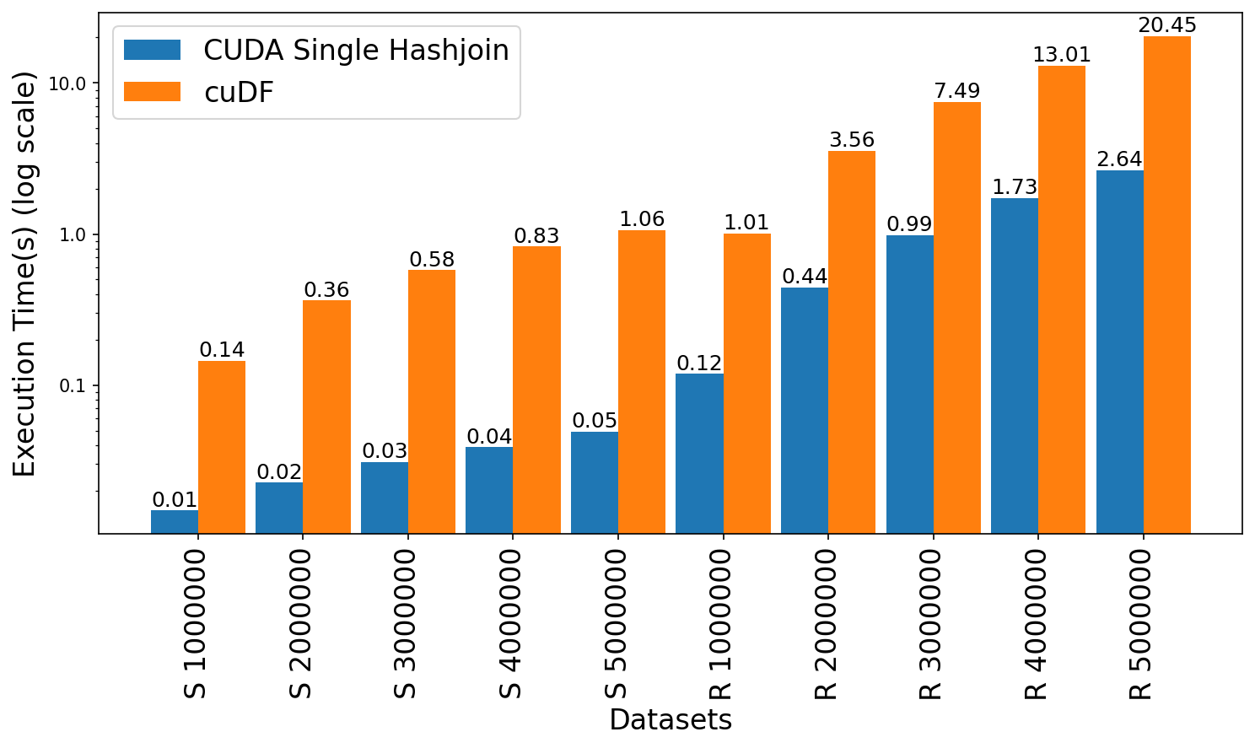
Join Performance Comparison: GPUJoin vs cuDF
Leadership Computing Facility, A. (2022). Argonne Leadership Computing Facility. Theta GPU Nodes. URL: https://www.alcf.anl.gov/support-center/theta-gpu-nodes
Notes:
Observe up to 21x speedup for string graph
Observe 7.6x to 8.4x speedup for random graph

Slide 54
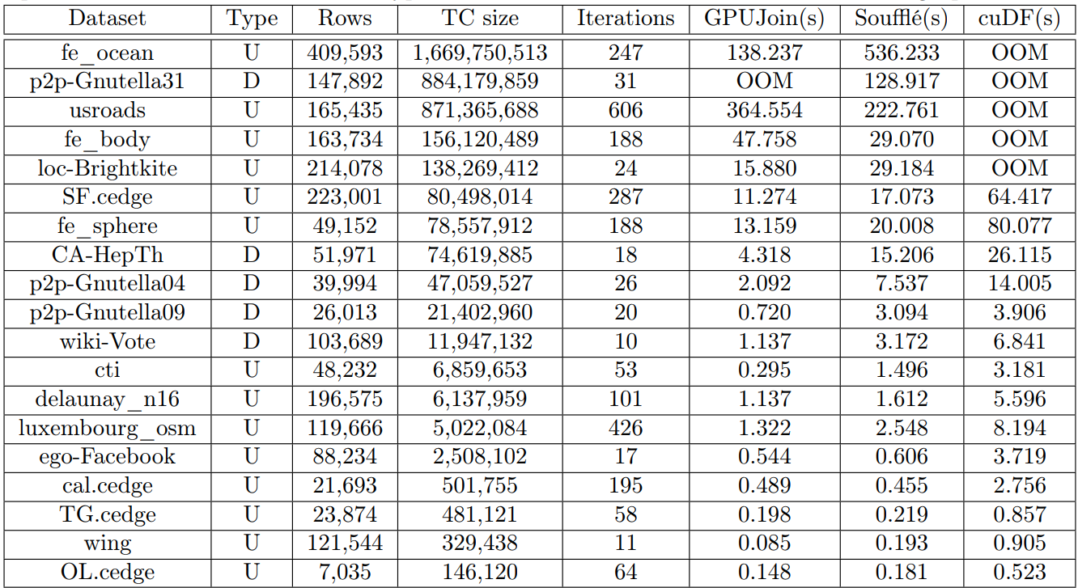
Transitive closure performance evaluation
Leadership Computing Facility, A. (2022). Argonne Leadership Computing Facility. Theta GPU Nodes. URL: https://www.alcf.anl.gov/support-center/theta-gpu-nodes
Notes:
Observe up to 21x speedup for string graph
Observe 7.6x to 8.4x speedup for random graph

Slide 55
Fallback: Memory usage

Slide 56
Roadmap
Introduction and motivation
Background
Enabling declarative analytics on heterogenous System
Off-the-shelf implementations (Accomplished)
Hash table on GPU (Accomplished)
Hash Join (Accomplished)
Hash indexed sorted array (Accomplished)
Multi-node multi-GPU implementation (Current focus)
Exploration of declarative scientific analytics
Declarative topological data analysis (Accomplished)
Persistent homology using declarative analytics (Current focus)
Timeline
Conclusion

Slide 57
Our efforts on developing Datalog backend
Off-the-shelf
Started with CPU and GPU based Python libraries
Compare GPU capabilities for iterative join operations
GPUJoin
Relational Algebra (RA) operations using CUDA
High performance GPU hashtable for iterative RA
GPULog
CUDA based SIMD API for deductive analytics
Novel Hash-Indexed Sorted Array data structure
mnmgJOIN
CUDA + MPI based design (Work in progress )
Multi node multi GPU based engine
Shovon, A. R., Dyken, L. R., Green, O., Gilray, T., & Kumar, S. (2022, November). Accelerating datalog applications with cudf. In 2022 IEEE/ACM Workshop on Irregular Applications: Architectures and Algorithms (IA3) (pp. 41-45). IEEE.
Shovon, A. R., Gilray, T., Micinski, K., & Kumar, S. (2023). Towards iterative relational algebra on the {GPU}. In 2023 USENIX Annual Technical Conference (USENIX ATC 23) (pp. 1009-1016).
Sun, Y., Shovon, A. R., Gilray, T., Micinski, K., & Kumar, S. Optimizing Datalog for the GPU. ASPLOS 2025 (Accepted).
Sewell, A., Fan, K., Shovon, A. R., Dyken, L., Kumar, S., & Petruzza, S. (2024, January). Bruck algorithm performance analysis for multi-gpu all-to-all communication. In Proceedings of the International Conference on High Performance Computing in Asia-Pacific Region (pp. 127-133).

Slide 58
Hash Indexed Sorted Array (HISA)
Enable fast lookups
Reduce memory
Grid Stride Loop
Murmur 3 hashing
0
1
...
511
*11
. . .
Block 0
35
44
11
23
*35
35
44
. . .
11
23
. . .
0
1
...
511
AtomicCAS
46
31
46
31
. . .
97
32
Block n
*46
97
32
Collision -> Linear probing (Position + 1) & hash table size
*97
Compact
Data Array
CUDA Threads
Key - Value
Sorted Index Map

Slide 59
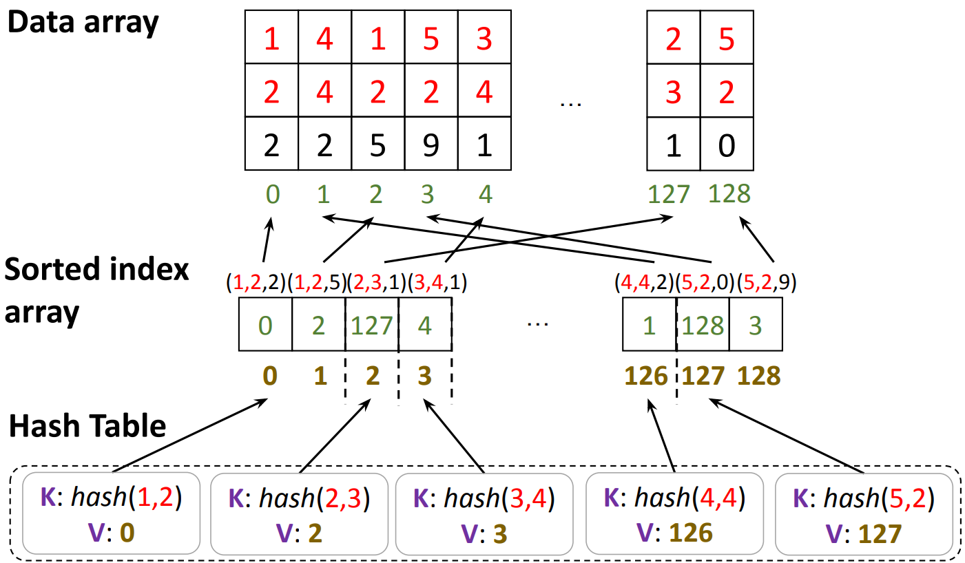
Hash Indexed Sorted Array (HISA)

Slide 60
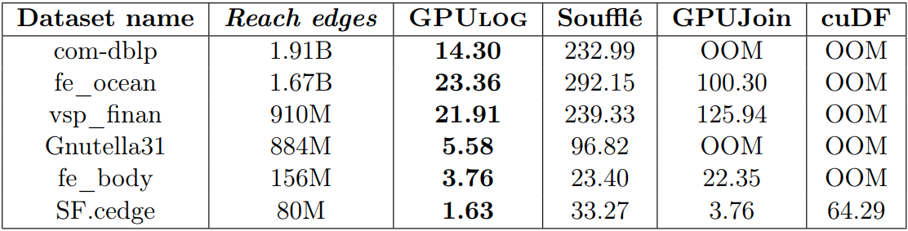
Performance Enhancement (Transitive closure)
Sun, Y., Shovon, A. R., Gilray, T., Micinski, K., & Kumar, S. Optimizing Datalog for the GPU. ASPLOS 2025 (Accepted).

Slide 61

Limitations
Limited to a single GPU that dictates scaling by available VRAM on the GPU
Memory overflow error for larger graphs

Slide 62
Roadmap
Introduction and motivation
Background
Enabling declarative analytics on heterogenous System
Off-the-shelf implementations (Accomplished)
Hash table on GPU (Accomplished)
Hash Join (Accomplished)
Hash indexed sorted array (Accomplished)
Multi-node multi-GPU implementation (Current focus)
Exploration of declarative scientific analytics
Declarative topological data analysis (Accomplished)
Persistent homology using declarative analytics (Current focus)
Timeline
Conclusion

Slide 63
Our efforts on developing Datalog backend
Off-the-shelf
Started with CPU and GPU based Python libraries
Compare GPU capabilities for iterative join operations
GPUJoin
Relational Algebra (RA) operations using CUDA
High performance GPU hashtable for iterative RA
GPULog
CUDA based SIMD API for deductive analytics
Novel Hash-Indexed Sorted Array data structure
mnmgJOIN
CUDA + MPI based design (Work in progress )
Multi node multi GPU based engine
Shovon, A. R., Dyken, L. R., Green, O., Gilray, T., & Kumar, S. (2022, November). Accelerating datalog applications with cudf. In 2022 IEEE/ACM Workshop on Irregular Applications: Architectures and Algorithms (IA3) (pp. 41-45). IEEE.
Shovon, A. R., Gilray, T., Micinski, K., & Kumar, S. (2023). Towards iterative relational algebra on the {GPU}. In 2023 USENIX Annual Technical Conference (USENIX ATC 23) (pp. 1009-1016).
Sun, Y., Shovon, A. R., Gilray, T., Micinski, K., & Kumar, S. Optimizing Datalog for the GPU. ASPLOS 2025 (Accepted).
Sewell, A., Fan, K., Shovon, A. R., Dyken, L., Kumar, S., & Petruzza, S. (2024, January). Bruck algorithm performance analysis for multi-gpu all-to-all communication. In Proceedings of the International Conference on High Performance Computing in Asia-Pacific Region (pp. 127-133).

Slide 64
How to parallelize iterative Relational Algebra?
(JOIN)
Hash-based partitioning
All-to-all communication
Hash Join
Data partitioning
Communication
Computation
Kumar, S., & Gilray, T. (2020). Load-balancing parallel relational algebra. In High Performance Computing: 35th International Conference, ISC High Performance 2020, Frankfurt/Main, Germany, June 22–25, 2020, Proceedings 35 (pp. 288-308). Springer International Publishing.

Slide 65
How to parallelize iterative Relational Algebra?
(JOIN)
Hash-based partitioning
Hash Join
Data partitioning
Computation
Kumar, S., & Gilray, T. (2020). Load-balancing parallel relational algebra. In High Performance Computing: 35th International Conference, ISC High Performance 2020, Frankfurt/Main, Germany, June 22–25, 2020, Proceedings 35 (pp. 288-308). Springer International Publishing.

Slide 66
(k)
The join column decides the GPU(bucket-id)
0 | 1
0 | 2
0 | 3
1 | 2
1 | 3
1 | 4
2 | 4
3 | 4
3 | 6
4 | 5
4 | 6
5 | 7
5 | 9
7 | 6
7 | 8
8 | 9
5
2
0
1
4
7
8
9
3
6
Hash-partitioning based on the
Join Column
Kumar, S., & Gilray, T. (2020). Load-balancing parallel relational algebra. In High Performance Computing: 35th International Conference, ISC High Performance 2020, Frankfurt/Main, Germany, June 22–25, 2020, Proceedings 35 (pp. 288-308). Springer International Publishing.
Notes:
In a join, it is necessary to iterate over all tuples where particular columns match a value or values taken from the ﬁrst operand of join—in which case the variable being matched should come ﬁrst and be a key in the outermost B-tree. The relation is thus explicitly indexed on this column.

Slide 67
(k)
0 | 1
0 | 2
0 | 3
0
1
2
The join column decides the GPU(bucket-id)
0 | 1
0 | 2
0 | 3
1 | 2
1 | 3
1 | 4
2 | 4
3 | 4
3 | 6
4 | 5
4 | 6
5 | 7
5 | 9
7 | 6
7 | 8
8 | 9
0 | 1
0 | 2
0 | 3
1 | 2
1 | 3
1 | 4
2 | 4
3 | 4
3 | 6
4 | 5
4 | 6
5 | 7
5 | 9
7 | 6
7 | 8
8 | 9
3 | 4
3 | 6
7 | 6
7 | 8
5
2
5 | 7
5 | 9
8 | 9
Hash(k) % 3
0
1
4
7
8
9
3
1 | 2
1 | 3
1 | 4
6
GPU (ID)
2 | 4
4 | 5
4 | 6
Kumar, S., & Gilray, T. (2020). Load-balancing parallel relational algebra. In High Performance Computing: 35th International Conference, ISC High Performance 2020, Frankfurt/Main, Germany, June 22–25, 2020, Proceedings 35 (pp. 288-308). Springer International Publishing.
Notes:
In a join, it is necessary to iterate over all tuples where particular columns match a value or values taken from the ﬁrst operand of join—in which case the variable being matched should come ﬁrst and be a key in the outermost B-tree. The relation is thus explicitly indexed on this column.

Slide 68
How to parallelize iterative Relational Algebra?
(JOIN)
Hash-based partitioning
All-to-all communication
Hash Join
Data partitioning
Communication
Computation

Slide 69
Relational Algebra Kernel
All to all comm
Join Project Hash
GPU 0
GPU 1
GPU 2
GPU 3
GPU 4
Kumar, S., & Gilray, T. (2020). Load-balancing parallel relational algebra. In High Performance Computing: 35th International Conference, ISC High Performance 2020, Frankfurt/Main, Germany, June 22–25, 2020, Proceedings 35 (pp. 288-308). Springer International Publishing.

Slide 70
Relational Algebra Kernel
All to all comm
Local inserts
Join Project Hash
GPU 0
GPU 1
GPU 2
GPU 3
GPU 4

Slide 71
Fixed point?
Relational Algebra Kernel
All to all comm
Local inserts
Join Project Hash
GPU 0
GPU 1
GPU 2
GPU 3
GPU 4

Slide 72
NO
Fixed point?
Relational Algebra Kernel
All to all comm
Local inserts
Join Project Hash
GPU 0
GPU 1
GPU 2
GPU 3
GPU 4

Slide 73
NO
Fixed point?
YES
Relational Algebra Kernel
All to all comm
Local inserts
STOP
Join Project Hash
GPU 0
GPU 1
GPU 2
GPU 3
GPU 4

Slide 74
All-to-all communication in multi-GPUs
The Bruck algorithm, while effective in multi-CPU setups, does not exhibit the same advantages in multi-GPU environments for all-to-all communication
NCCL’s default all-to-all implementation is better suited for GPU-specific workloads
From this finding, we will explore techniques to optimize all-to-all communication in CUDA-Aware-MPI
Sewell, A., Fan, K., Shovon, A. R., Dyken, L., Kumar, S., & Petruzza, S. (2024, January). Bruck algorithm performance analysis for multi-gpu all-to-all communication. In Proceedings of the International Conference on High Performance Computing in Asia-Pacific Region (pp. 127-133).

Slide 75
Single join with efficient communication
Develop efficient single-join strategies optimized for multi-node, multi-GPU environments, addressing both iterative and non-iterative joins
Strong and weak scaling performance analysis with different buffer preparation techniques in all-to-all communication:
CUDA-Aware-MPI with GPUDirect:
Sorting-based technique
Two-pass approach
CUDA with MPI and CPU Buffers:
Sorting-based technique
Two-pass approach

Slide 76
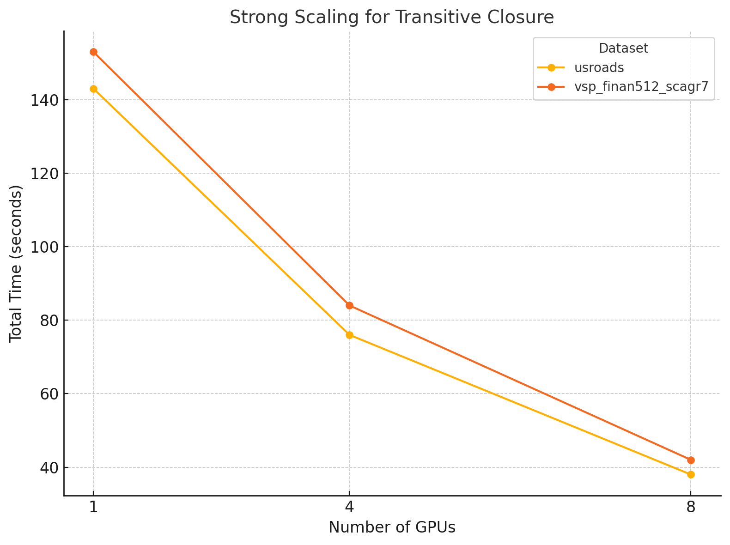
Strong scaling experiment for Transitive Closure using CUDA-Aware-MPI

Slide 77
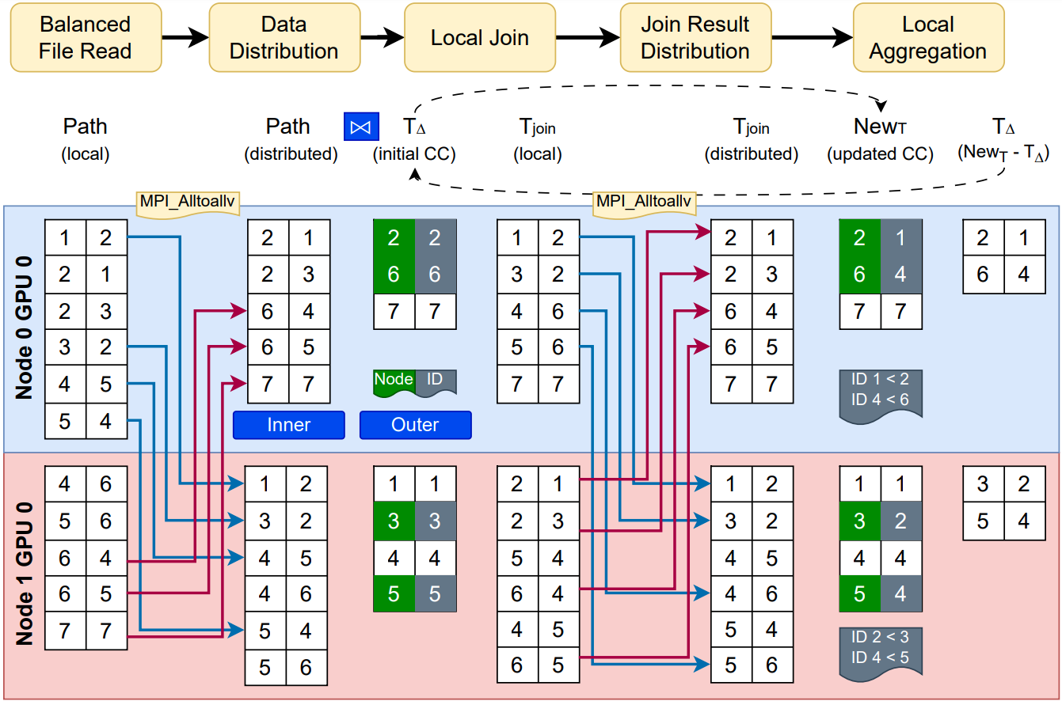
Recursive aggregation technique for connected component

Slide 78
Roadmap
Introduction and motivation
Background
Enabling declarative analytics on heterogenous System
Off-the-shelf implementations (Accomplished)
Hash table on GPU (Accomplished)
Hash Join (Accomplished)
Hash indexed sorted array (Accomplished)
Multi-node multi-GPU implementation (Current focus)
Exploration of declarative scientific analytics
Declarative topological data analysis (Accomplished)
Persistent homology using declarative analytics (Current focus)
Timeline
Conclusion

Slide 79
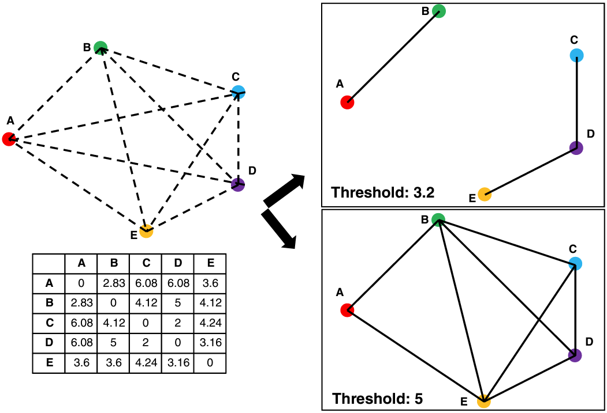
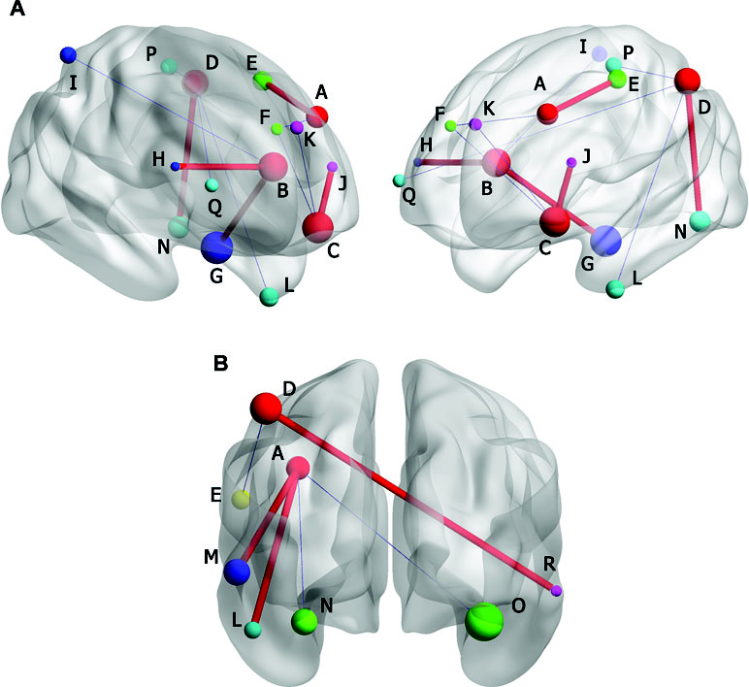
Brain networks as graph applications
Kumar, S., Shovon, A. R., & Deshpande, G. (2023). The robustness of persistent homology of brain networks to data acquisition‐related non‐neural variability in resting state fMRI. Human Brain Mapping, 44(13), 4637-4651.

Slide 80
Brain networks as graph applications
Kumar, S., Shovon, A. R., & Deshpande, G. (2023). The robustness of persistent homology of brain networks to data acquisition‐related non‐neural variability in resting state fMRI. Human Brain Mapping, 44(13), 4637-4651.

Slide 81
Brain networks as graph applications
Kumar, S., Shovon, A. R., & Deshpande, G. (2023). The robustness of persistent homology of brain networks to data acquisition‐related non‐neural variability in resting state fMRI. Human Brain Mapping, 44(13), 4637-4651.

Slide 82
Brain networks as graph applications
Kumar, S., Shovon, A. R., & Deshpande, G. (2023). The robustness of persistent homology of brain networks to data acquisition‐related non‐neural variability in resting state fMRI. Human Brain Mapping, 44(13), 4637-4651.

Slide 83
Brain networks as graph applications
Two thresholds yield graphs of completely different topologies!
Kumar, S., Shovon, A. R., & Deshpande, G. (2023). The robustness of persistent homology of brain networks to data acquisition‐related non‐neural variability in resting state fMRI. Human Brain Mapping, 44(13), 4637-4651.

Slide 84
Roadmap
Introduction and motivation
Background
Enabling declarative analytics on heterogenous System
Off-the-shelf implementations (Accomplished)
Hash table on GPU (Accomplished)
Hash Join (Accomplished)
Hash indexed sorted array (Accomplished)
Multi-node multi-GPU implementation (Current focus)
Exploration of declarative scientific analytics
Declarative topological data analysis (Accomplished)
Persistent homology using declarative analytics (Current focus)
Timeline
Conclusion

Slide 85
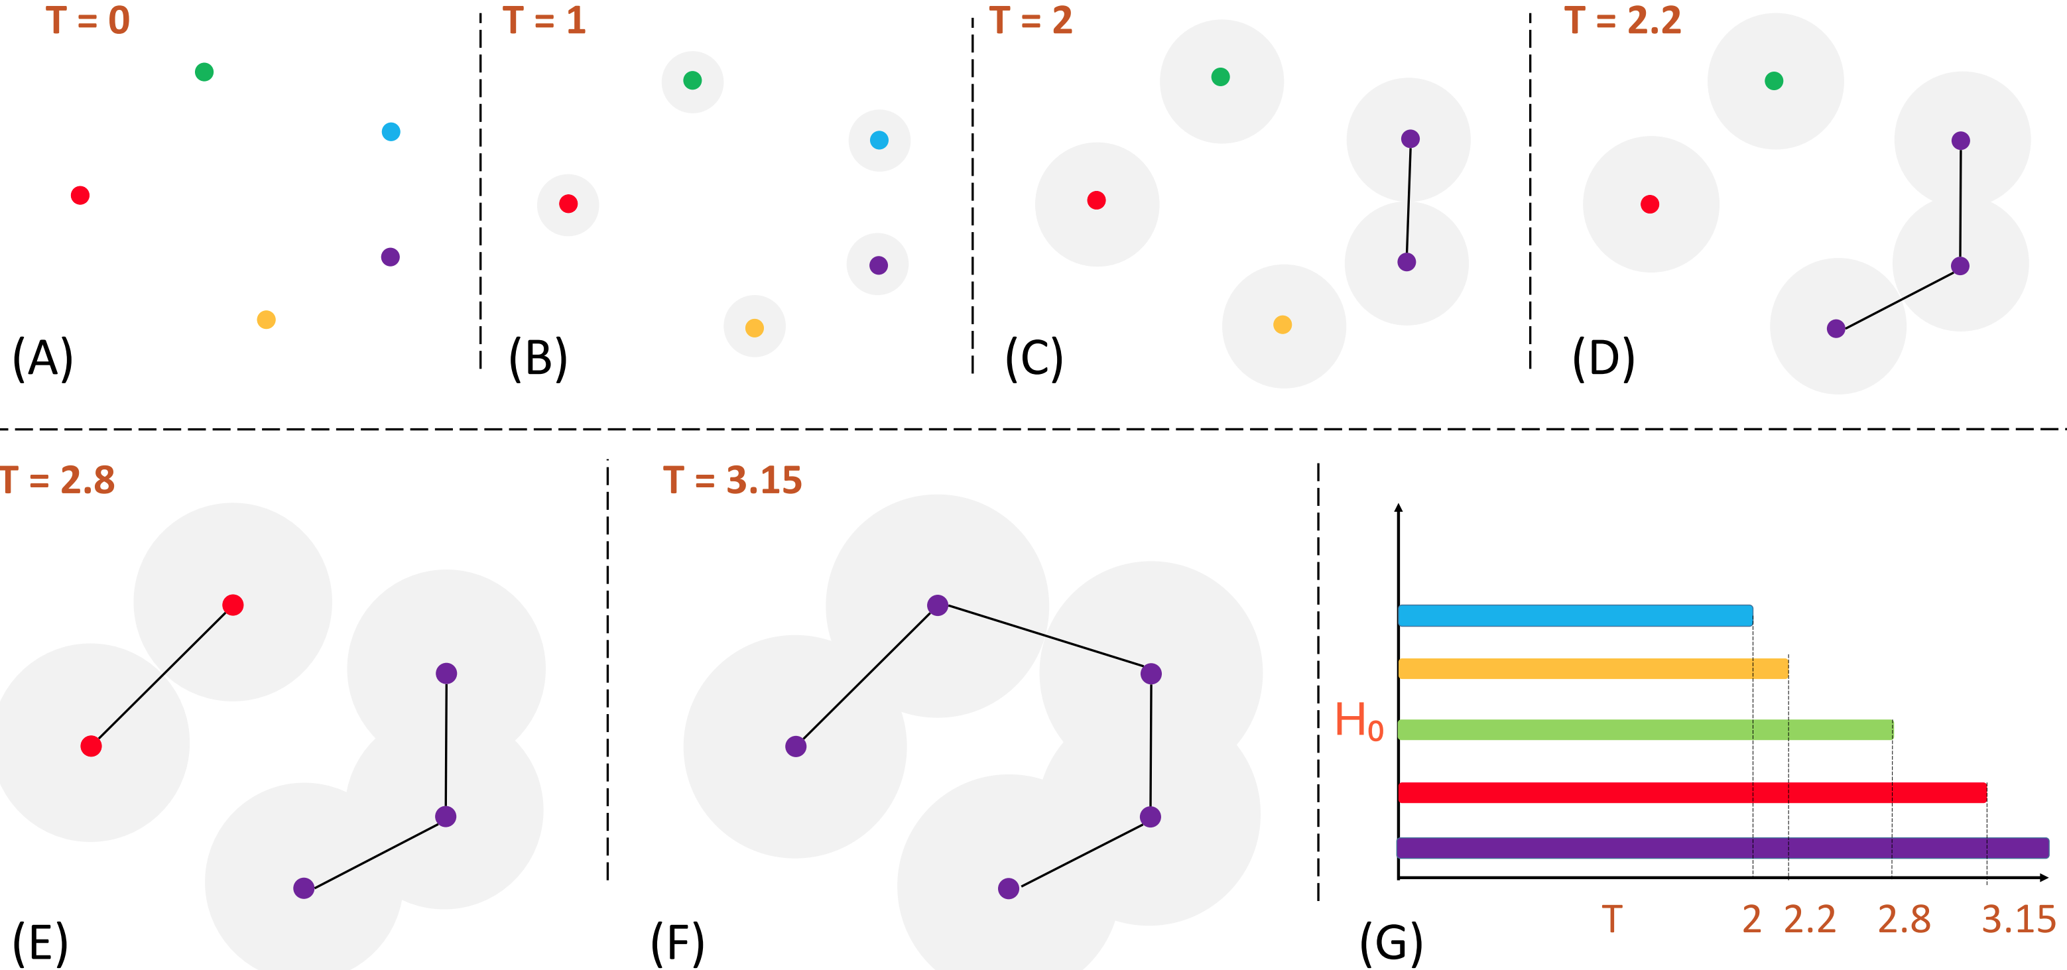
Computing Persistent Homology (Point Cloud)

Slide 86
Computing Persistent Homology (Point Cloud)

Slide 87
Computing Persistent Homology (Point Cloud)

Slide 88
Computing Persistent Homology (Point Cloud)

Slide 89
Computing Persistent Homology (Point Cloud)

Slide 90
Computing Persistent Homology (Point Cloud)

Slide 91
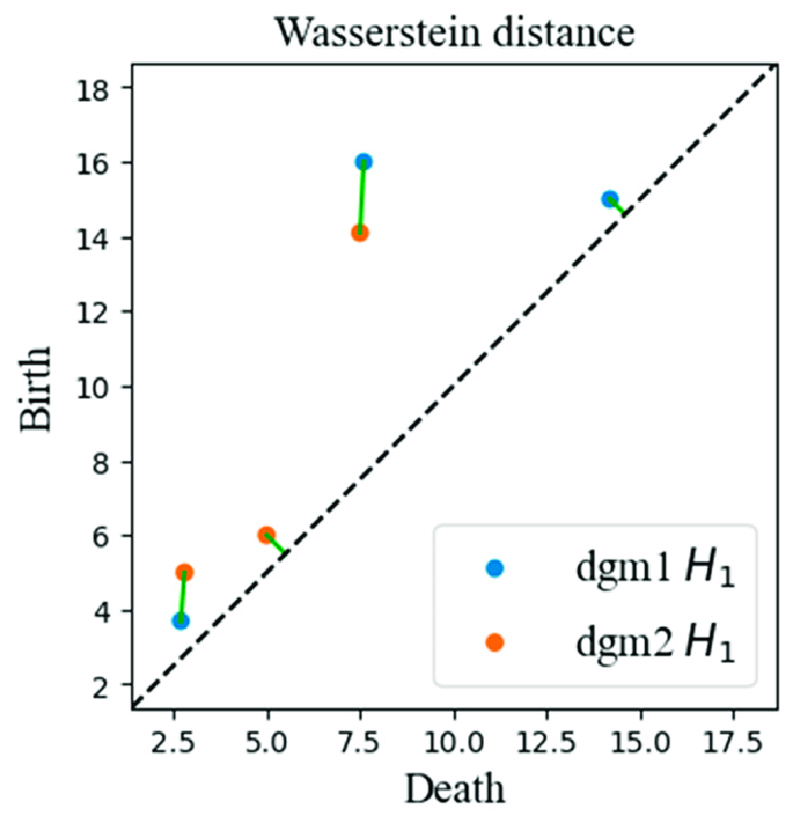
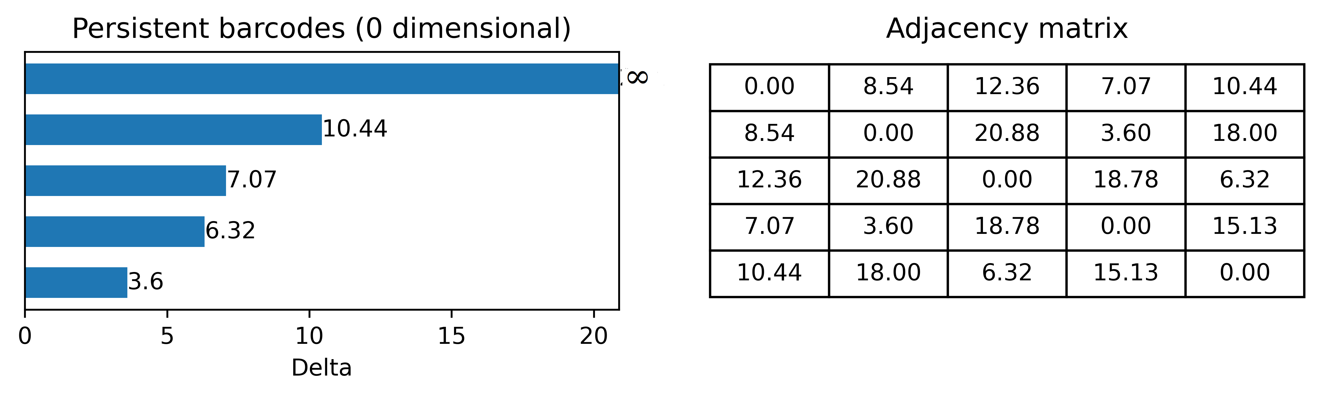
Persistent Barcodes using Connected Component
Persistent Homology tracks birth and death of topological features in the graph
0-dim barcodes: each bar shows when each features (connected component) born and die
Persistent diagram: shows persistent barcodes in 2D
Kumar, S., Shovon, A. R., & Deshpande, G. (2023). The robustness of persistent homology of brain networks to data acquisition‐related non‐neural variability in resting state fMRI. Human Brain Mapping, 44(13), 4637-4651.

Slide 92

Limitations
Imperative and complex high-dimensional data analysis pipelines

Slide 93
Roadmap
Introduction and motivation
Background
Enabling declarative analytics on heterogenous System
Off-the-shelf implementations (Accomplished)
Hash table on GPU (Accomplished)
Hash Join (Accomplished)
Hash indexed sorted array (Accomplished)
Multi-node multi-GPU implementation (Current focus)
Exploration of declarative scientific analytics
Declarative topological data analysis (Accomplished)
Persistent homology using declarative analytics (Current focus)
Timeline
Conclusion

Slide 94
Declarative Topological Data Analysis
Use Datalog to simplify persistent barcodes computations
1
Explore potential applications of using declarative TDA
2
Scale TDA methods to large datasets in HPC environment
3

Slide 95
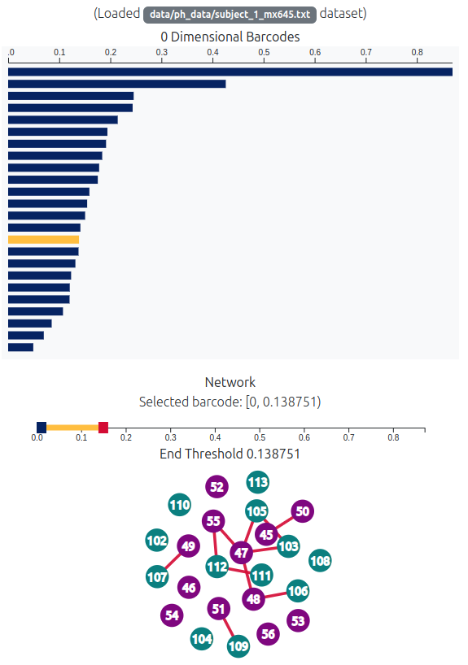
Persistent Barcodes using Declarative Analytics
Construct a filtration
Compute persistence of connected components at each threshold
Build graph based on the selected threshold
Web URL: https://harp-lab.github.io/TDA/

Slide 96
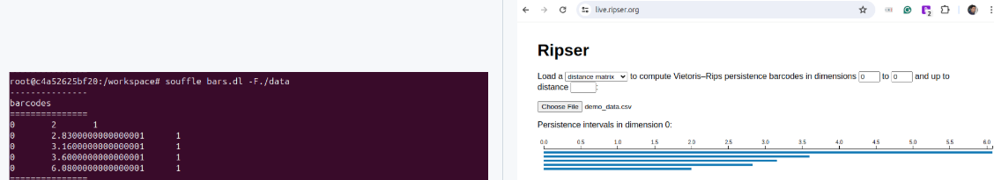

Persistent Barcodes using Declarative Analytics
Use Datalog for efficient connected components calculation
Successfully implemented 0-dimensional barcodes using Soufflé
Extend barcodes computation to the SLOG engine for scalable multi-node HPC environments
Gilray, T., Sahebolamri, A., Kumar, S., & Micinski, K. (2022). Higher-Order, Data-Parallel Structured Deduction. arXiv preprint arXiv:2211.11573.

Slide 97
Roadmap
Introduction and motivation
Background
Enabling declarative analytics on heterogenous System
Off-the-shelf implementations (Accomplished)
Hash table on GPU (Accomplished)
Hash Join (Accomplished)
Hash indexed sorted array (Accomplished)
Multi-node multi-GPU implementation (Current focus)
Exploration of declarative scientific analytics
Declarative topological data analysis (Accomplished)
Persistent homology using declarative analytics (Current focus)
Timeline
Conclusion

Slide 98
Milestones and timeline (December 2024 to July 2025)
Developing a multi-node, multi-GPU Datalog engine (International Conference on Supercomputing - ICS 25)
Designing a TDA-based clustering pipeline for temporal fMRI analysis (IEEE Access)
Exploring persistent barcode computations in declarative analytics (Workshop paper)
Preparing the PhD dissertation
January
ICS submission
February
Access review
March
Workshop paper
April
Dissertation
May
Workshop paper submission
July
Defense

Slide 99
Roadmap
Introduction and motivation
Background
Enabling declarative analytics on heterogenous System
Off-the-shelf implementations (Accomplished)
Hash table on GPU (Accomplished)
Hash Join (Accomplished)
Hash indexed sorted array (Accomplished)
Multi-node multi-GPU implementation (Current focus)
Exploration of declarative scientific analytics
Declarative topological data analysis (Accomplished)
Persistent homology using declarative analytics (Current focus)
Timeline
Conclusion

Slide 100



Conclusion
Explored optimization techniques for iterative relational algebra operations
Proposed first scalable multi-node multi-GPU backend for Datalog
Extend Datalog's potential in novel graph applications such as topological data analysis
mnmgJOIN Github
Declarative TDA Github
Publications

Slide 101
Thank You
ashov@uic.edu

Slide 102
List of publications
Shovon, A. R., Dyken, L. R., Green, O., Gilray, T., & Kumar, S. (2022, November). Accelerating datalog applications with cudf. In 2022 IEEE/ACM Workshop on Irregular Applications: Architectures and Algorithms (IA3) (pp. 41-45). IEEE.
Shovon, A. R., Gilray, T., Micinski, K., & Kumar, S. (2023). Towards iterative relational algebra on the {GPU}. In 2023 USENIX Annual Technical Conference (USENIX ATC 23) (pp. 1009-1016).
Sun, Y., Shovon, A. R., Gilray, T., Micinski, K., & Kumar, S. Optimizing Datalog for the GPU. ASPLOS 2025 (Accepted).
Sewell, A., Fan, K., Shovon, A. R., Dyken, L., Kumar, S., & Petruzza, S. (2024, January). Bruck algorithm performance analysis for multi-gpu all-to-all communication. In Proceedings of the International Conference on High Performance Computing in Asia-Pacific Region (pp. 127-133).
Kumar, S., Shovon, A. R., & Deshpande, G. (2023). The robustness of persistent homology of brain networks to data acquisition‐related non‐neural variability in resting state fMRI. Human Brain Mapping, 44(13), 4637-4651.
Shovon, A. R., Kumar, S., & Deshpande, G. Topology assisted clustering of temporal fMRI brain networks with use-case in mitigating non-neural multi-site variability. Manuscript in submission.
Chandrashekar, D. S., Karthikeyan, S. K., Korla, P. K., Patel, H., Shovon, A. R., Athar, M., ... & Varambally, S. (2022). UALCAN: An update to the integrated cancer data analysis platform. Neoplasia, 25, 18-27.
Balakavi, K., Janga, R., Shovon, A. R., Dempsey, D., Lefkowitz, E., & Kumar, S. (2023, October). Scalable, interactive and hierarchical visualization of virus taxonomic data. In 2023 Workshop on Visual Analytics in Healthcare (VAHC) (pp. 34-40). IEEE.
Rubey, D., Chandrashekar, D. S., Shovon, A. R., Puli, G. C., Karthikeyan, S. K., ... & Varambally, S. UALCAN Mobile, an app for cancer gene expression data analysis. Manuscript in submission.

Slide 103
Hash Join Process
Outer
Relation
Hash Table
35
44
11
23
11
23
. . .
. . .
46
31
46
31
. . .
97
32
35
44
Key - Value
97
32
Key - Value

Slide 104
Hash Join Process
Hash Join Relation
With
Duplicate records
Hash Join Relation
With
Duplicate records
⨝
Hash Table
Inner
Relation
Deduplicated records
Deduplication

Slide 105
Our efforts on developing Declarative TDA
Static fMRI [P5]
Connected component based persistent barcodes used for static brain networks analysis
Removes non neural variability due to different sampling periods
Temporal fMRI [P6]
Topological clustering of temporal data with connected components
A potential study of using declarative TDA on high dimensional data
Kumar, S., Shovon, A. R., & Deshpande, G. (2023). The robustness of persistent homology of brain networks to data acquisition‐related non‐neural variability in resting state fMRI. Human Brain Mapping, 44(13), 4637-4651.
Shovon, A. R., Kumar, S., & Deshpande, G. Topology assisted clustering of temporal fMRI brain networks with use-case in mitigating non-neural multi-site variability. Manuscript in submission.

Slide 106
Persistent Barcodes using Declarative Analytics
Construct a filtration
Compute persistence of connected components at each threshold
Build graph based on the selected threshold
Web URL: https://harp-lab.github.io/TDA/

Slide 107
High-dimensional data analysis using connected components
Verify
Declarative TDA can compactly represent topological features of FCNs
Demonstrate
FCN networks are statistically similar despite variations in input parameters
Remove
Non-neural variability in multi-site case-control studies
Kumar, S., Shovon, A. R., & Deshpande, G. (2023). The robustness of persistent homology of brain networks to data acquisition‐related non‐neural variability in resting state fMRI. Human Brain Mapping, 44(13), 4637-4651.

Slide 108
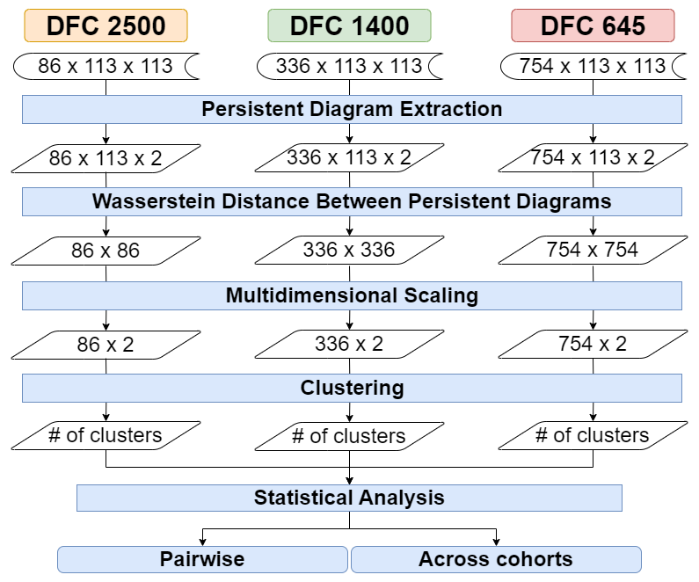
Temporal dataset analysis using connected component
Shovon, A. R., Kumar, S., & Deshpande, G. Topology assisted clustering of temporal fMRI brain networks with use-case in mitigating non-neural multi-site variability. Manuscript in submission.

